Slide 1
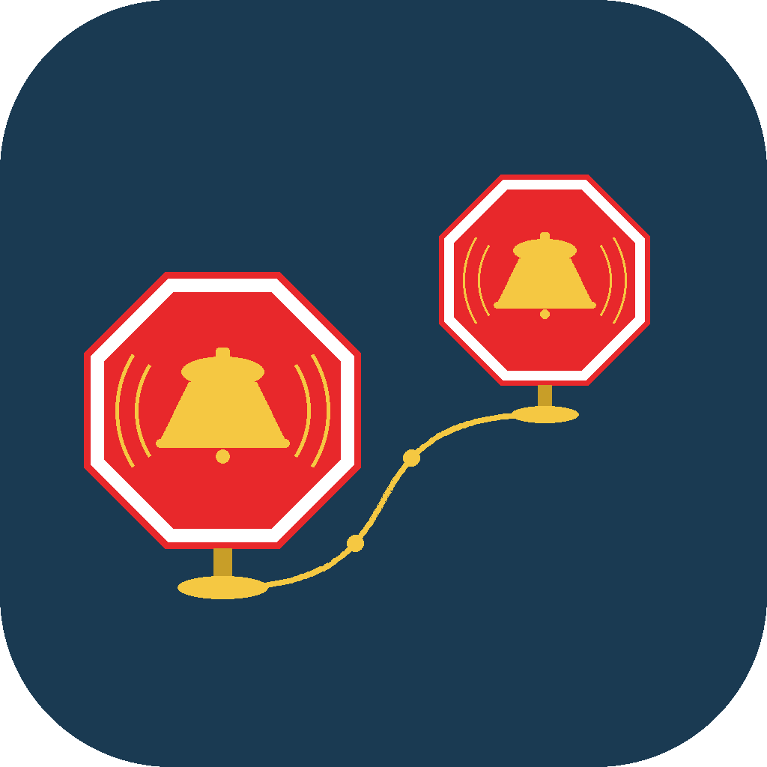
GEONAP
Location-Based Alarms for Commuters and Travelers
A complete feature overview for press, partners, and evaluators.
Press & Partner Reference

Slide 2

OVERVIEW
GeoNap Wakes You Up Based on Where You Are
GeoNap sets alarms by location instead of time — the app notifies the user the moment they arrive at, or leave, any point on the map.
Designed for anyone who wants to rest, work, or relax during a trip without missing their stop: commuters, travelers, and road-trip passengers.
Available in 13 languages, with alarms that work fully offline once set.
GeoNap

Slide 3
HOW IT WORKS
Set It Once. GeoNap Takes It From There.
1
2
3
Pin Your Stop
Nap, Ride, Relax
Wake Up Right On Time
Drop a pin on any address, station, or transit stop — or search for it by name.
GeoNap quietly tracks location in the background — no need to keep the app open.
A full-screen alarm fires the moment the user arrives or leaves — it cuts through silent mode.
GeoNap

Slide 4

RELIABILITY
Works Independently of Station Displays and Announcements
No reliance on PA announcements — alerts are triggered by the rider's own phone location, not by what's audible onboard.
No reliance on departure boards — a broken, outdated, or missing display has no effect on whether the alarm fires correctly.
No language barrier to the alert itself — GeoNap's own interface is available in 13 languages, independent of station signage.
GeoNap

Slide 5
CORE FEATURE
Creating a Location Alarm
1
2
3
4
Name & Note
Pin the Spot
Set the Trigger
Save
Give the alarm a name and an optional note shown in the notification.
Search an address, tap the map, or enter exact GPS coordinates in DD, DMS, or DDM format.
Choose On Arrival or On Departure, then set the radius with a slider.
Optionally enable Auto-Notify, pick a sound, and save — up to 20 active alarms at once.
GeoNap

Slide 6

TRIGGER MODES
Distance or Time-to-Arrival
Distance — fires when the user crosses a set radius around the pin; best for a fixed boundary like a single station.
Time before arrival — fires a set number of minutes before arrival, computed from current travel speed; ideal for napping on a train or bus.
Adaptive fallback — in long tunnels, time-based triggers fall back to a nearby-distance trigger automatically.
GeoNap

Slide 7
CORE FEATURE
Transit Alarms: Live Schedules, No Coordinates Needed
1
2
3
4
Agency
Route
Stop
Confirm
Choose a built-in worldwide agency (Amtrak, BART, MBTA, CTA, GO Transit, and more) or any public GTFS feed URL.
Browse or search routes; each shows its type — rail, subway, bus, ferry, and more.
All stops are listed sorted by distance from the user's current location.
Review agency, route, and stop, then set name, radius, direction, and sound.
GeoNap

Slide 8

SMART FEATURE
Calendar Scanning: Trip Detection, Always Opt-In
Off by default — the user must explicitly enable it in Settings and grant calendar access.
User-selected calendars only — only the primary calendar is checked by default; Birthdays and Holiday calendars are excluded automatically.
Automatic or manual scans — scan periodically in the background, or only when the user taps Scan Now.
Always a choice — each suggested trip must be individually approved or declined before an alarm is created.
GeoNap

Slide 9

SMART FEATURE
Auto-Notify: Keep Others Informed, Automatically
Location-triggered, not action-triggered — the message is prepared the moment the geofence event happens.
Covers the whole trip — works on both On Departure and On Arrival alarms, so contacts know when a traveler left as well as when they got there.
Pre-filled and ready — e.g. “[Arrival] I arrived at Grand Central at 9:14 AM” — just tap Send.
Hands-free option available — a Shortcuts Personal Automation can send the message with no approval step, the next time GeoNap is opened.
Global contact defaults — a shared contact list pre-fills every new alarm with Auto-Notify enabled.
GeoNap

Slide 10

SMART FEATURE
Siri & Shortcuts: Hands-Free by Design
“Create a GeoNap” — Siri asks for a name, location, and trigger direction, then saves the alarm.
“Enable / Disable my GeoNap” — re-activate or deactivate a saved alarm by voice.
“Notify my contacts via GeoNap” — returns the pre-filled Auto-Notify message for use in a Personal Automation.
No setup required — all shortcuts are available immediately and customizable in the iOS Shortcuts app.
GeoNap

Slide 11

SMART FEATURE
Apple Home Automation: A Home That's Ready on Arrival
HomeKit-compatible — works with lights, thermostats, air conditioning, locks, blinds, fans, and any “Arrive Home” scene.
Runs automatically — set up once via a Shortcuts Personal Automation tied to the same location as a GeoNap alarm.
Alarm and automation together — linking a Run Shortcut action fires the audible alarm and the Home automation at the same moment.
GeoNap

Slide 12

SMART FEATURE
On the Road: CarPlay and Alarm Sounds
CarPlay display — firing alarms appear on the car's screen; stop or snooze from the connected phone.
System sound options — Vibrate Only, Default, or Critical (bypasses silent mode and Do Not Disturb).
Bundled travel sounds — boat horn, cable car bell, steam train, sailboat bell, airplane landing, and airport chime.
GeoNap

Slide 13


PERSONALIZATION
Set Up Once, Fits How Each User Travels
Units & Clock
Coordinate Formats
Metric or imperial distance, and 12- or 24-hour time — set independently of the device's system settings.
Enter and view GPS coordinates as DD, DMS, or DDM — whichever a user is used to.
13 Languages
Auto-Notify Defaults
English, Spanish, French, German, Italian, Portuguese, Arabic, Hindi, Japanese, Simplified Chinese, Russian, Thai, Vietnamese.
A shared contact list that pre-fills automatically across every new alarm.
GeoNap

Slide 14
AT A GLANCE
Every Alarm's Status, Visible Instantly
Indicator | Meaning
Status dot | Green = active · Red = fired · Orange = snoozed · Gray = disabled
Transit badge | Shows the route type — train, subway, bus, ferry, and more
Repeat badge | Alarm resets automatically after each trip
Auto-Notify badge | Contacts will be messaged automatically when this alarm fires
Schedule badges | Alarm is limited to a time window and/or specific days of the week
Swipe right to enable/disable an alarm instantly; swipe left to delete it.
GeoNap

Slide 15

TYPICAL USE CASE
The Daily Transit Commute
A commuter sets an alarm at their station once. Each morning, GeoNap wakes them just before arrival — automatically, with the alarm resetting itself for the next trip.
USE CASE
Train & Subway
Commuters
Repeating alarms plus a distance or time-based trigger make this a “set once” experience.
GeoNap

Slide 16


MORE USE CASES
Built for Every Kind of Trip
Bus Riders
Arriving Home
A departure alarm fires the moment the user leaves their stop's area — a reliable reminder to head out.
Arrival triggers a HomeKit automation at the same time as the alarm — lights, heat, and comfort, ready on arrival.
Road-Trip Passengers
Travelers Abroad
A waypoint alarm removes the need to watch the map for the whole drive.
Alarms at a hotel, airport, or meeting location work in any of 13 supported languages.
GeoNap

Slide 17
TYPICAL USE CASE
Know They're On Their Way — and Home Safe
Auto-Notify isn't limited to the traveler — enabling it on any alarm sends a message to saved contacts the moment the trip starts and the moment it ends, so the people waiting don't have to ask.
USE CASE
Family &
Friends
Works on both On Departure and On Arrival triggers, and pairs with the same hands-free automation used for solo alerts.
GeoNap

Slide 18

PRIVACY & DATA HANDLING
On-Device by Design
Calendar data is read entirely on the device and is never uploaded or shared.
Calendar Scanning is off by default and requires explicit opt-in and calendar access.
Location Services can be set to Always so alarms fire in the background; full disclosure is available in-app.
An opt-in debug log captures permission status, region and alarm events, and errors — nothing is sent automatically.

Slide 19
AVAILABILITY
Where GeoNap Runs
Device | Requirement
iPhone | iOS 26.0 or later
iPad | iPadOS 26.0 or later
Apple Watch | watchOS 26.0 or later (companion features)
Connectivity | Offline for standard alarms; internet needed only for transit feed downloads
Location Services must be set to Always so alarms can fire in the background.
GeoNap

Slide 20

SUPPORT
Built-In Diagnostics for Fast Troubleshooting
Opt-in debug log — enabled in Settings, with a clear description of what's recorded before it starts.
What's captured — device model, iOS version, location permission status, region and alarm events, transit feed downloads, and errors.
Nothing automatic — the log file stays on-device until the user chooses to share it, e.g. via the Files app.
GeoNap

Slide 21
Learn More About GeoNap
A complete reference for coverage, partnership, or evaluation.
Media & Partner Inquiries
Add press/partner contact details here

